Slide 1
Santa Diary
My Mad-157 project

Slide 2
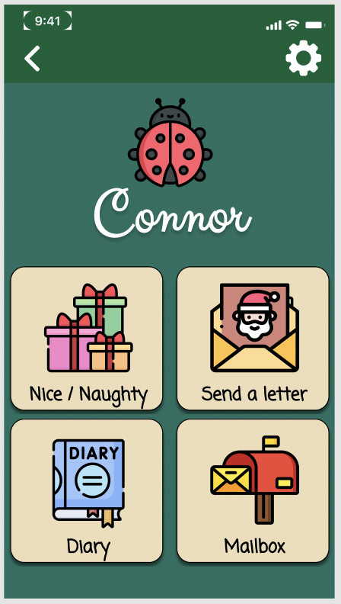
What’s the end goal?

Slide 3
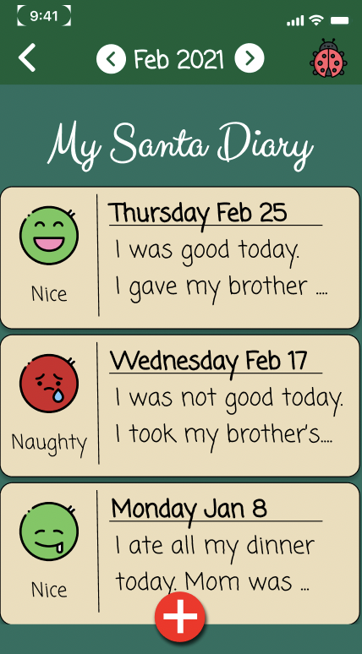
Read / Write Diary Entries

Slide 4
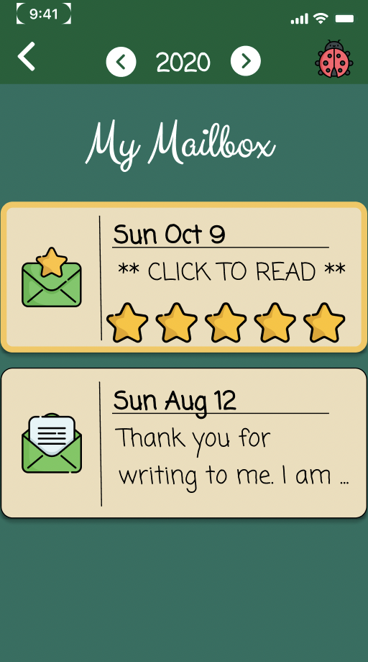
Read / Write Santa Letters

Slide 5
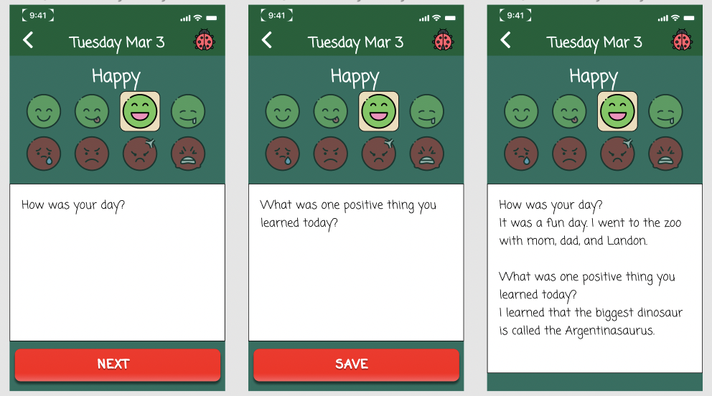
Add Diary entries

Slide 6
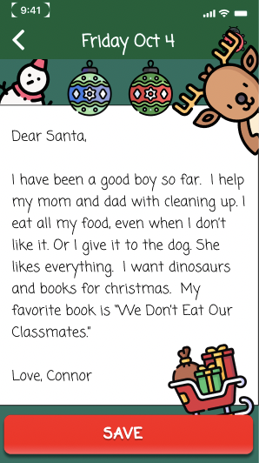
Read and write letters to santa

Slide 7

Work on file structure using filemanager
Connor
Settings
Diary
Letters
Users
Landon

Slide 8
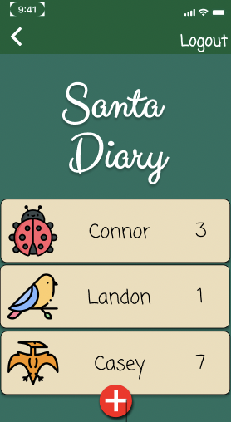
Step 1
Set up “accounts”
Create / Delete users

Slide 9
STEP 2
Start with the diary entries pages

Slide 10
Write classes and structs
These will handle all the data storage functions
User will enter text and DiaryManager will handle the organization and storing the data.
DiaryManager().addEntry(text: String, date: String, etc.)

Slide 11
A search feature?
User may want to view entries from a different time period
Write the functions used to sort through data and print all relevant data to console.
Example:
DiaryManager().getEntries(year: String, Month: String)

